Slide 1


IMAGE TAGGING AND ROAD OBJECT DETECTION
Guide : Prof. Anoop M. Namboodiri
Mentor : Sangeeth Reddy
Richard Deepak
Rahul Juluru
Sridhar Deshpande
Kshama Pandey

Slide 2
Agenda
Objective
Methodology and design considerations
Outcome in stages with final outcome
Challenges
Application Demo

Slide 3
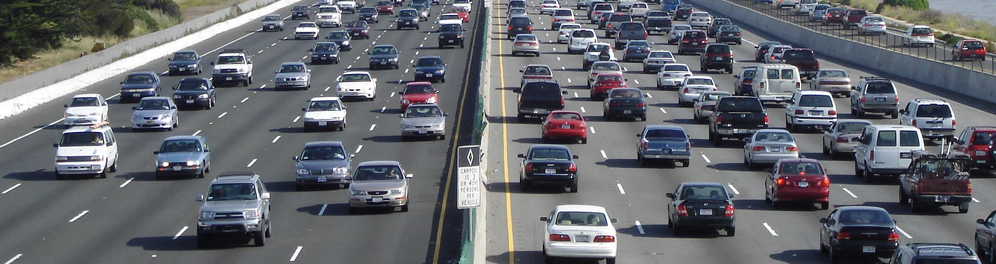
Objective
Build an application to detect multiple objects, tag and tracking in a video.

Slide 4
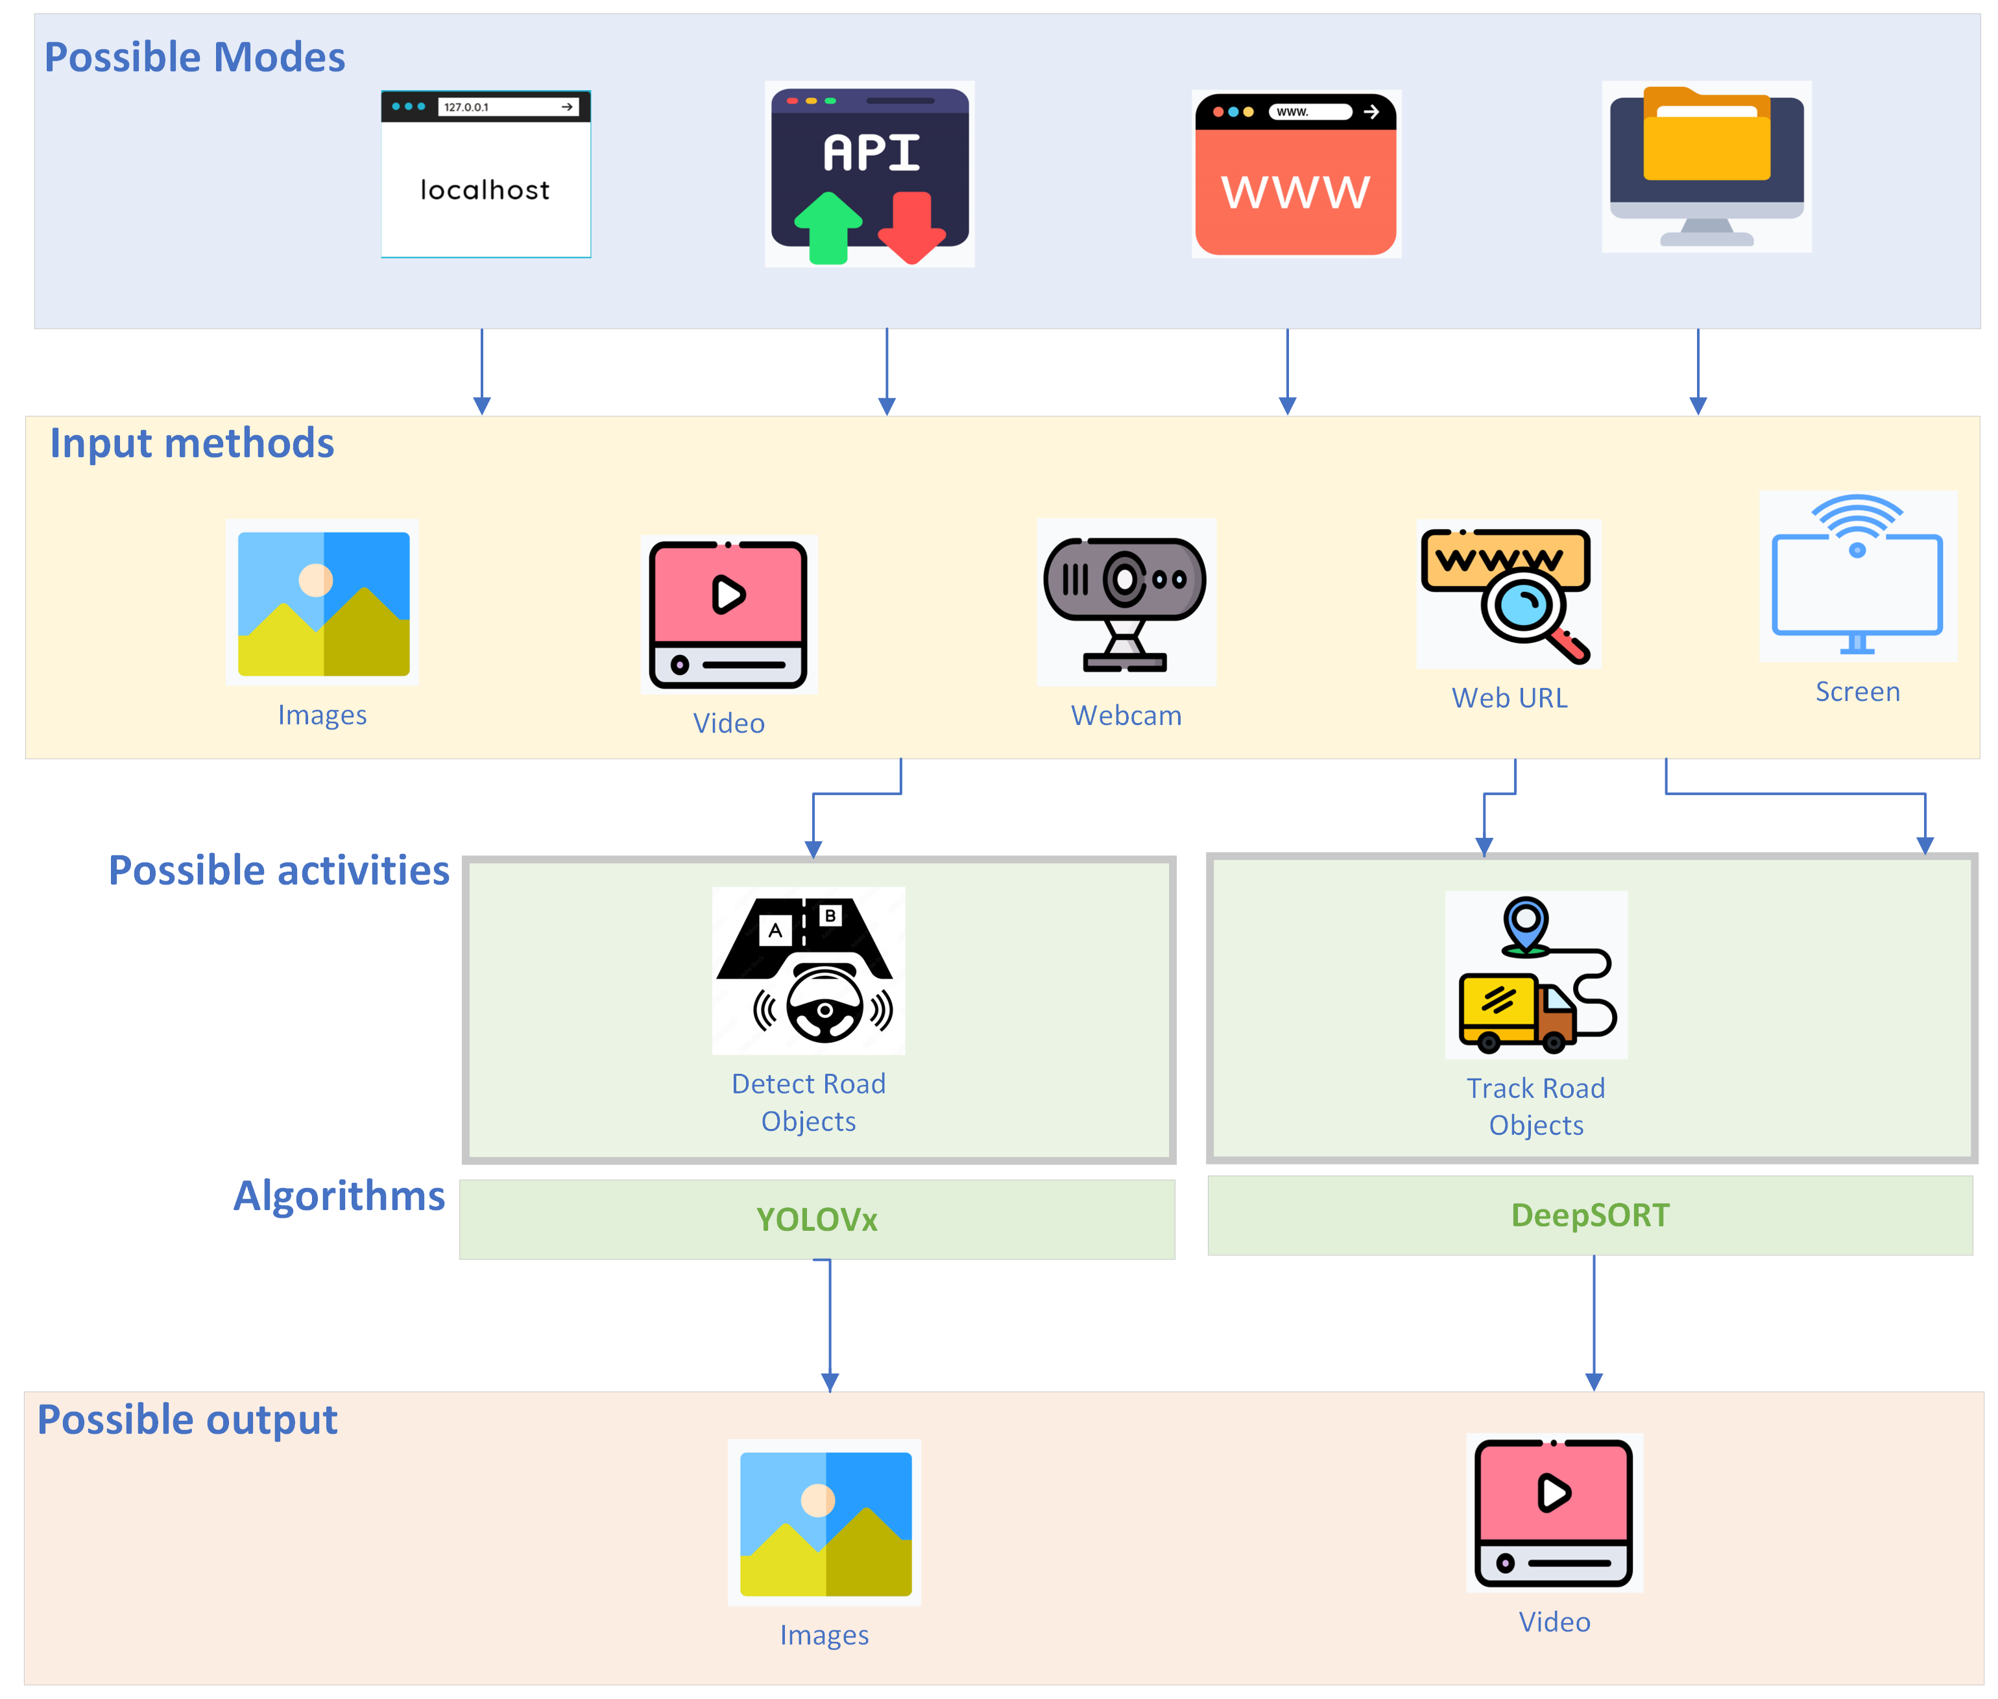
Methodology and design considerations
Notes:
Change

Slide 5
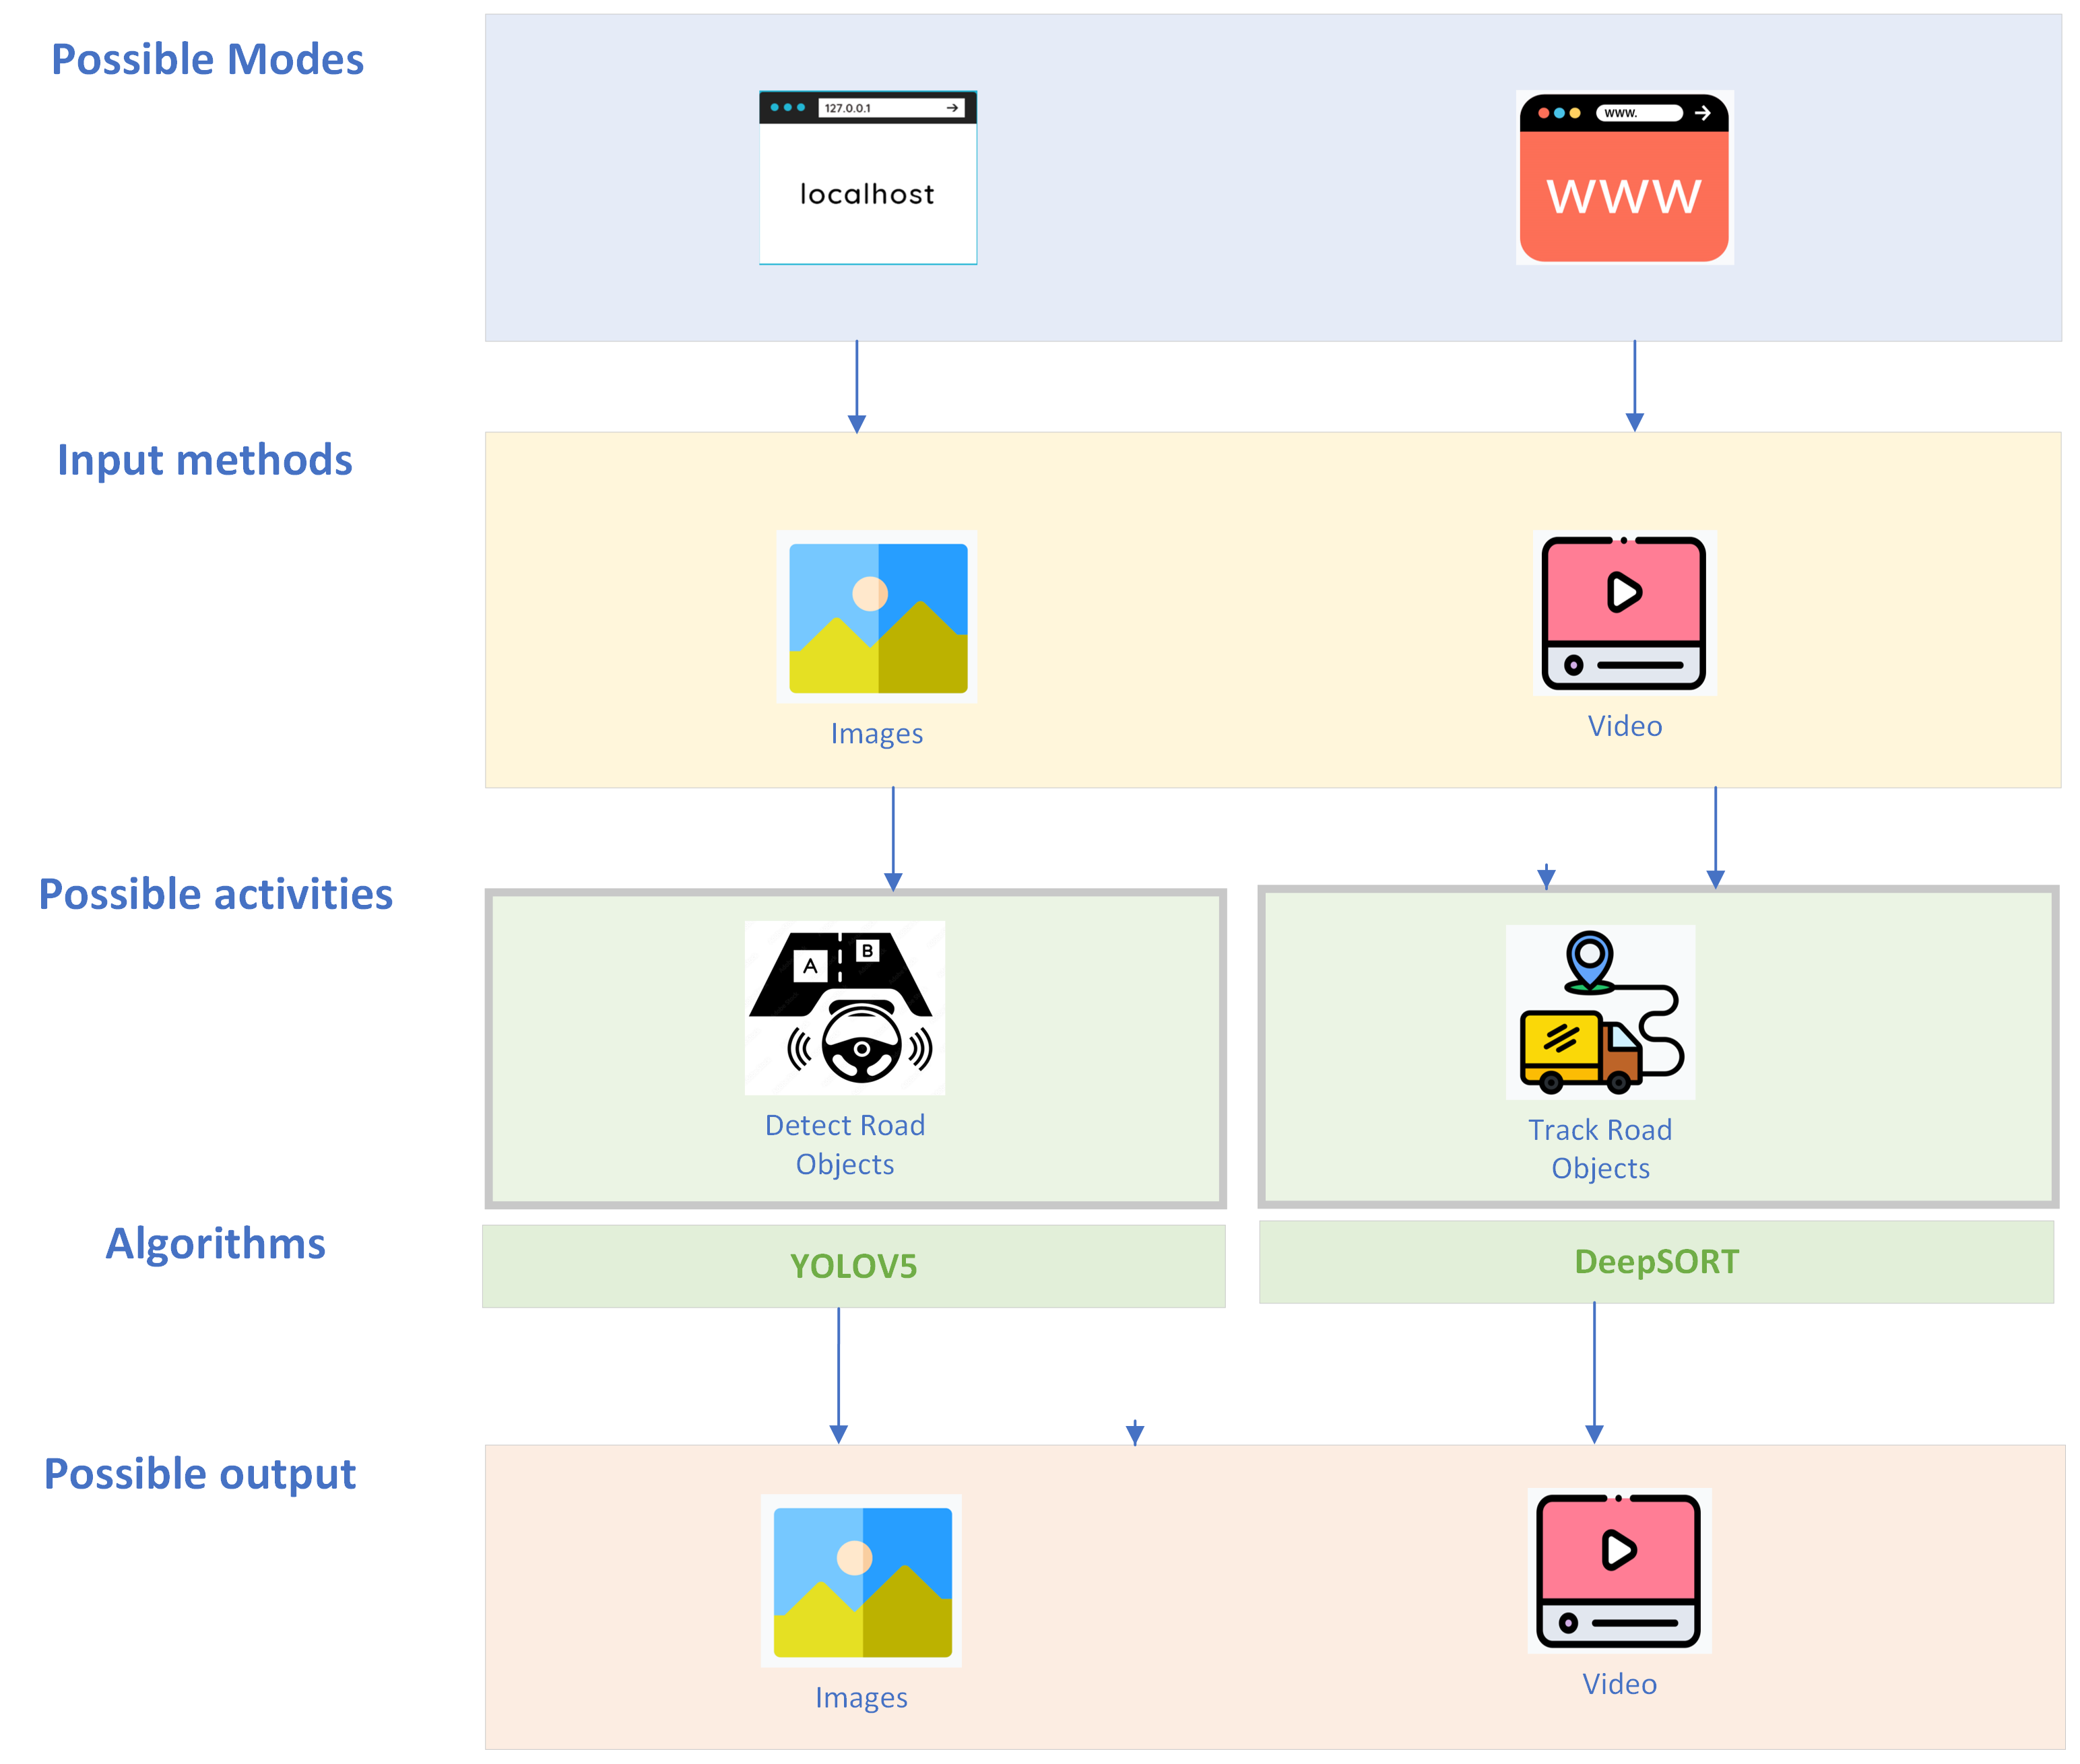
Methodology and design considerations
Project Scope

Slide 6
Outcome in stages
Understand the data
Learn about BDD100K dataset and download the images from website. Load these images with labels in Google Drive for further processing
Identify the object detection algorithm
Understand the repository with detailed analysis on the way algorithm works and its efficiency. We have chosen YOLOv5 for this purpose and understood steps for download its repository
Identify the tracking algorithm
We have chosen Deep SORT algorithm as our tracking algorithm as it has greater efficiency and support community.
Process images & videos for object detection
Train , validate and test the BDD100K images & videos with YOLOv5 algorithm. Obtain the final model weights generated from the epoch which can be the base for object detection.
Process tracking algorithm for videos
Test the BDD100K video samples downloaded form website to understand the tracking efficiency after downloading their repo and run the required files. Customize the solution to import essential packages / libraries.
Build the streamlit application and
deploy the solution
Develop the streamlit application to use the model weights for object detection and tracking. Deploy the entire solution to Streamlit Cloud after pushing entire solution to GIT repository.

Slide 7
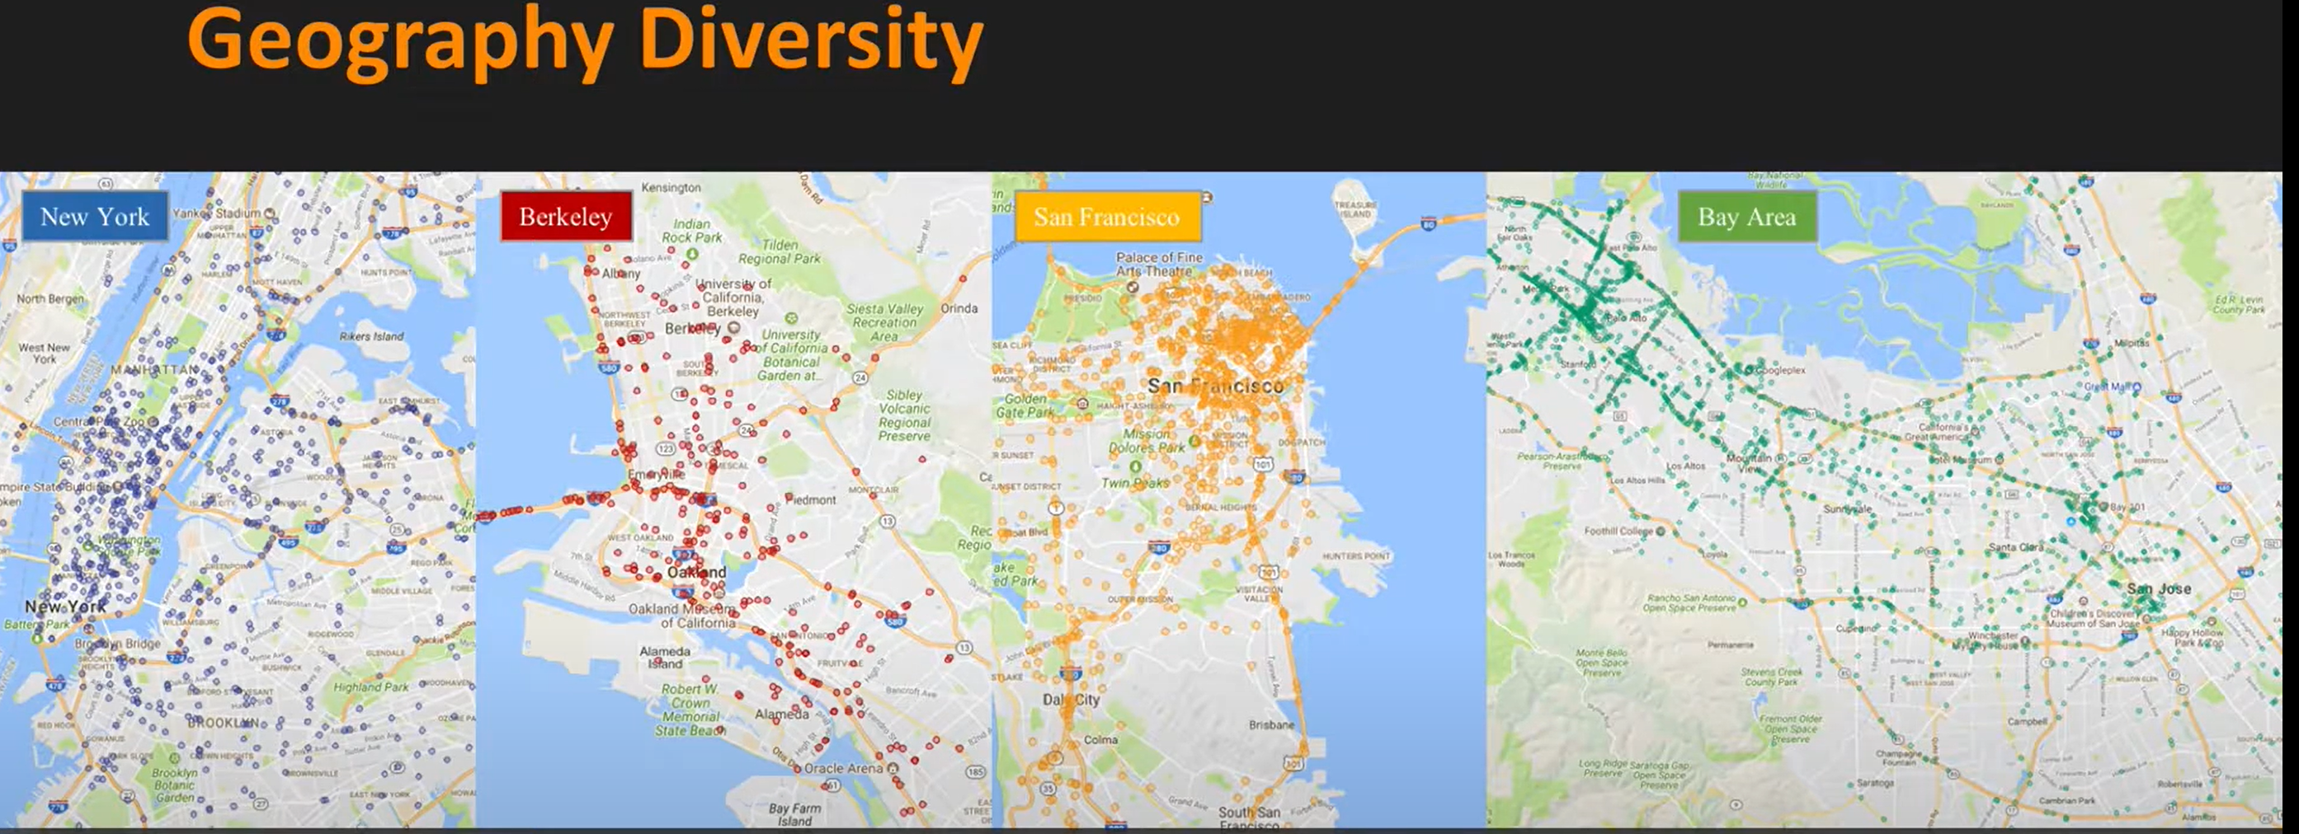
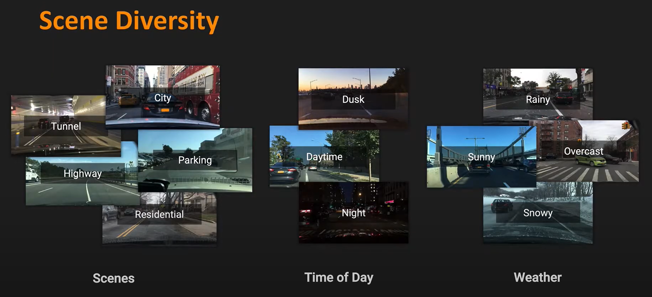
Outcome in stages
Stage 1 – Understand the data
Consists of 100,000 videos.
Each video is about 40 seconds long, 720p, and 30 fps
BDD100K Dataset
Geographically diverse
Scene Diversity : Scene = City , Tunnel , Highway , Parking , Residential
Time of the day = Dusk , Daytime , night
Weather = Rainy , Sunny , Overcast , Snowy
There are >10 objects per image with pixel annotation and tracking

Slide 8
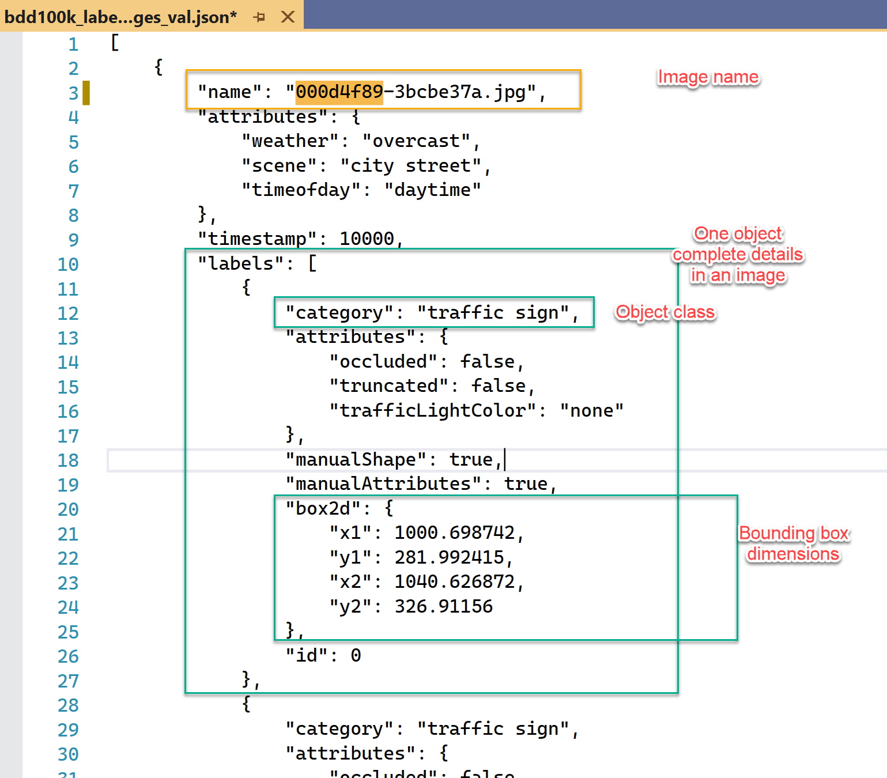
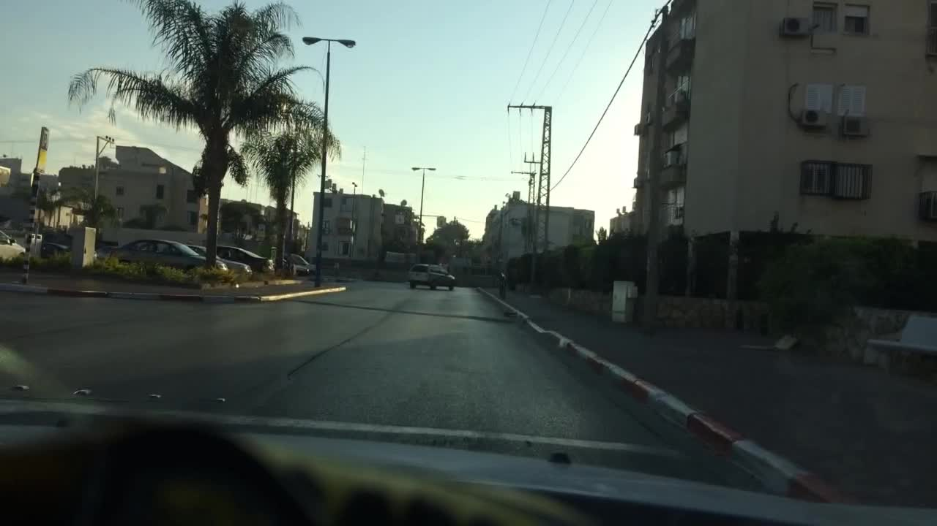
Outcome in stages
Stage 1 – Understand the data
Original Image
BDD100k dataset bounding box JSON format

Slide 9

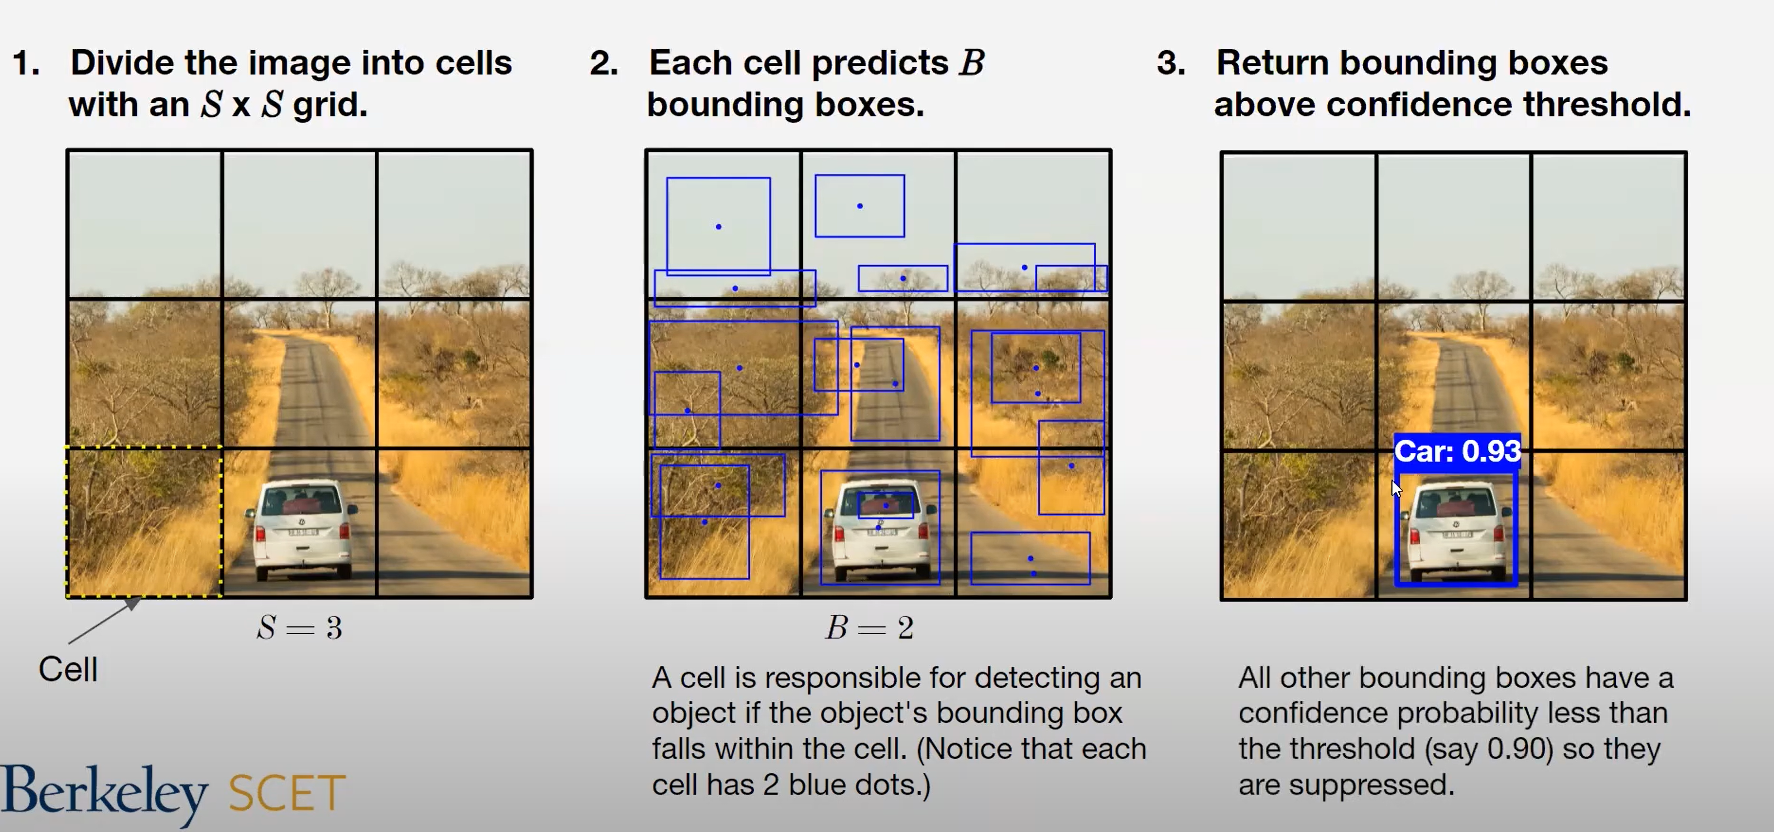
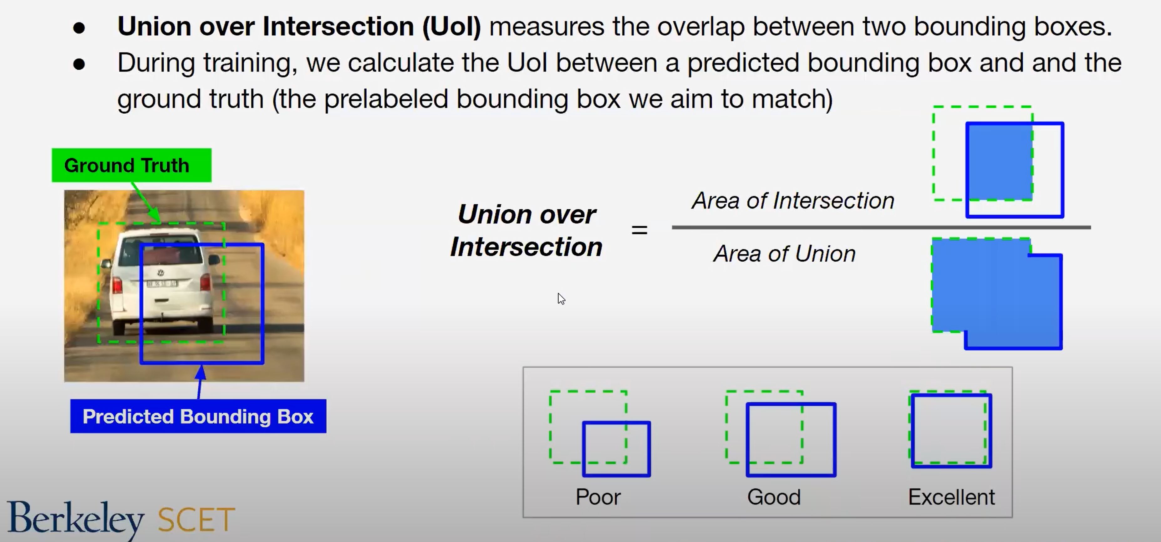
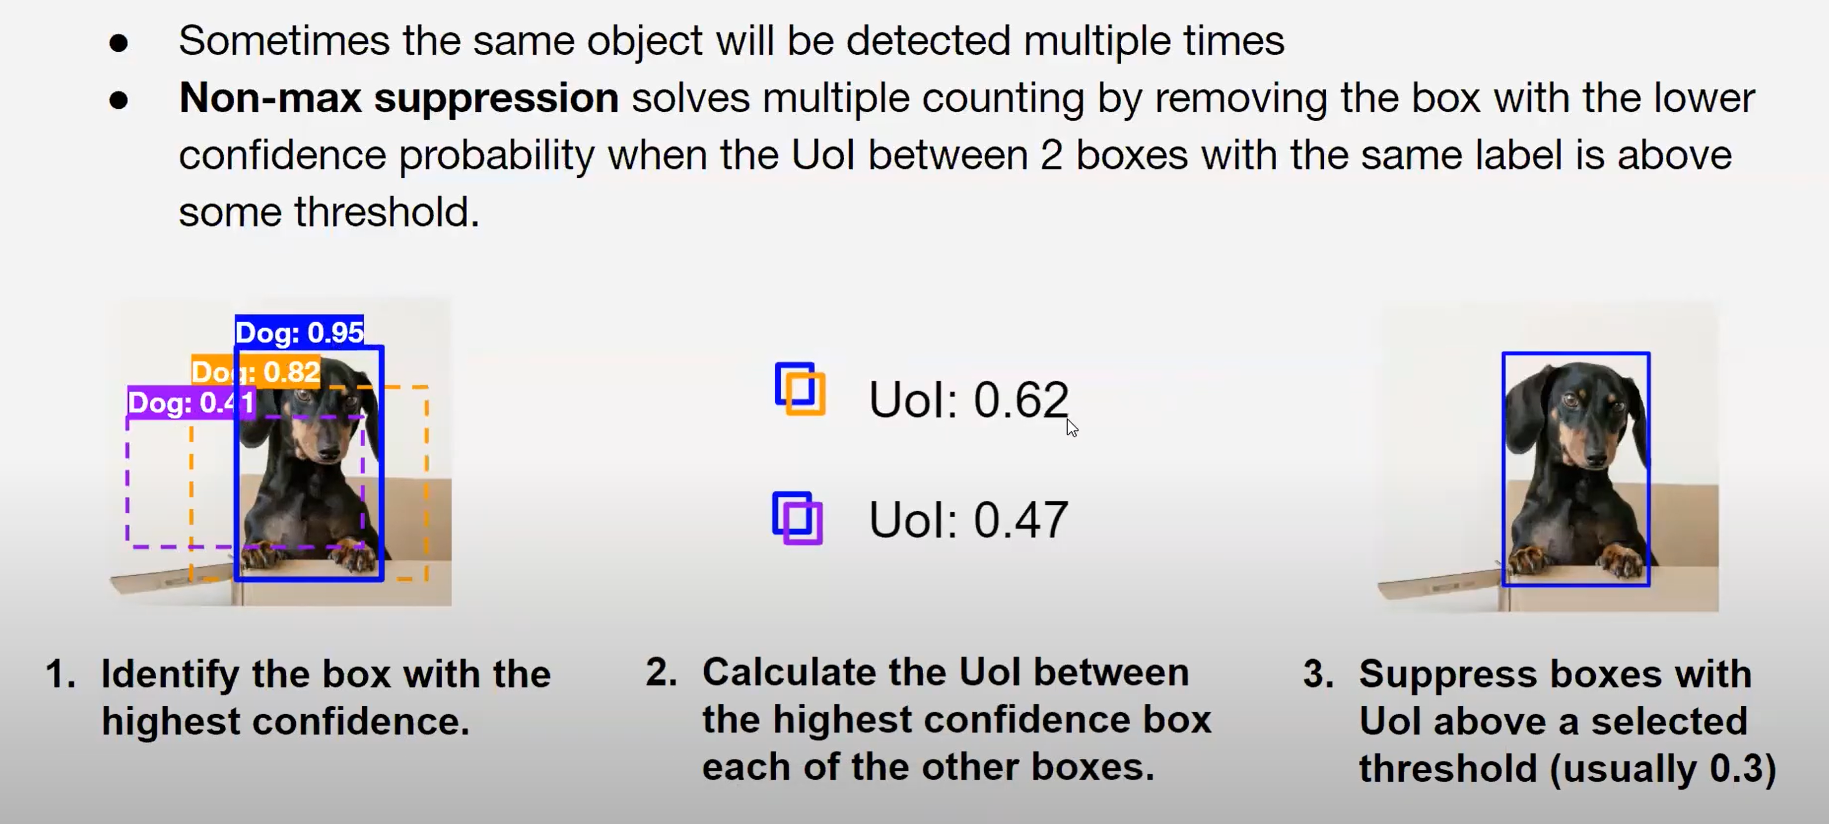
Outcome in stages
Stage 2 – Identify the object detection algorithm
Choice of algorithm
Divide the image to cells
Predicting bounding boxes
within each cell
Selection of bounding box which is above confidence threshold
Intersection over Union
Non max suppression

Slide 10
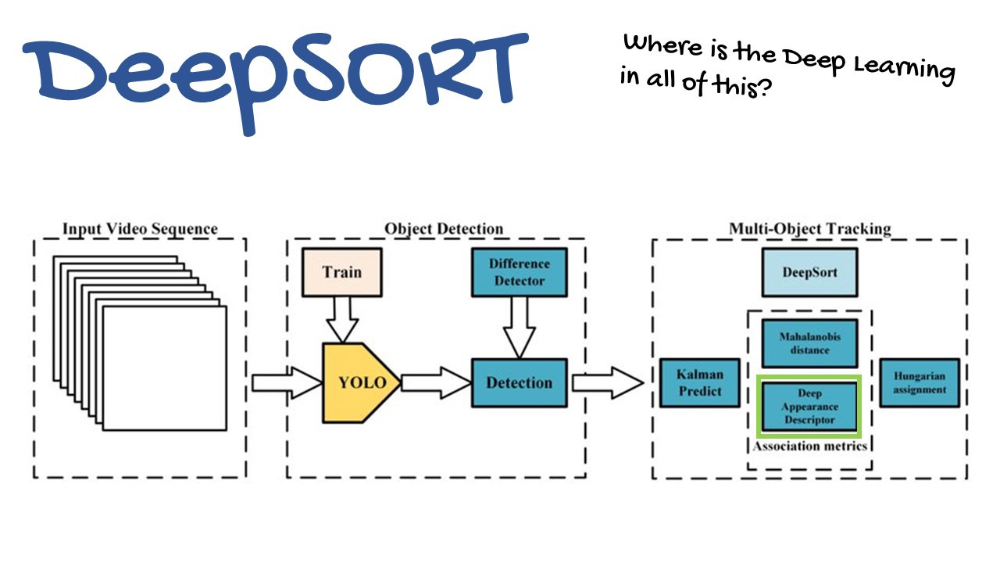
Outcome in stages
Stage 3 – Identify the tracking algorithm
Choice of algorithm

Slide 11
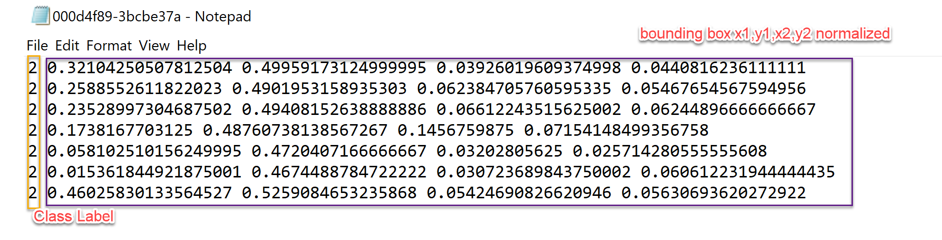
Outcome in stages
Stage 4 – Process images and videos for object detection
Original Image
BDD100k dataset bounding box JSON format
Converted to TXT file with required class and Bbox with mapping data and labels

Slide 12
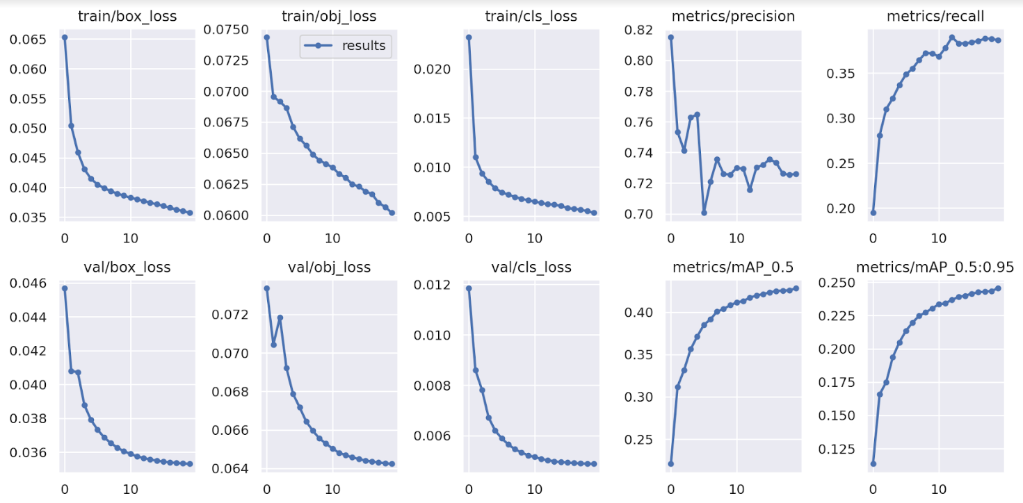
Actual Outcomes
Preliminary results

Slide 13
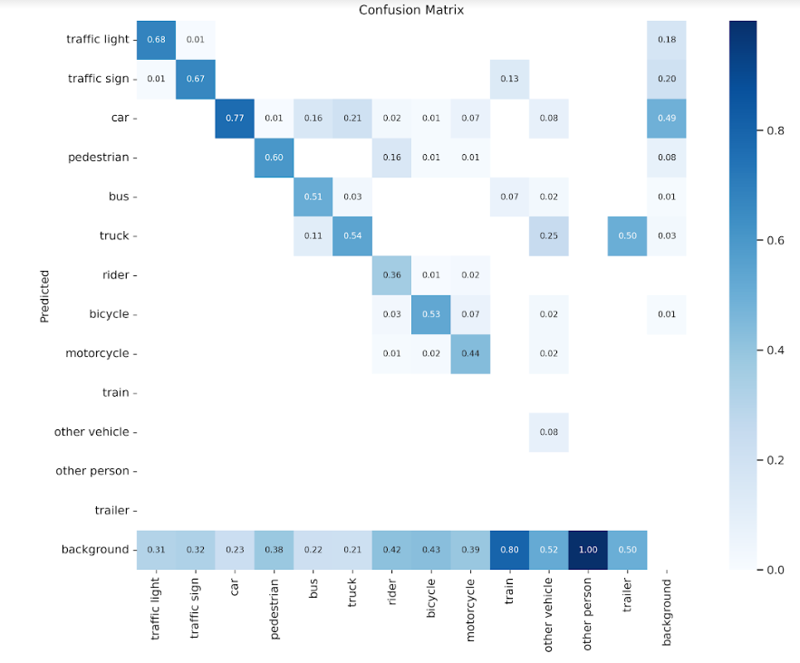
Actual Outcomes
Preliminary results – Confusion Matrix

Slide 14
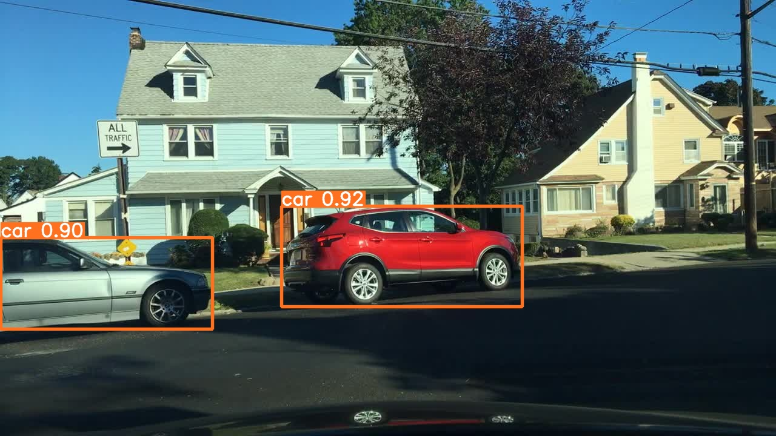
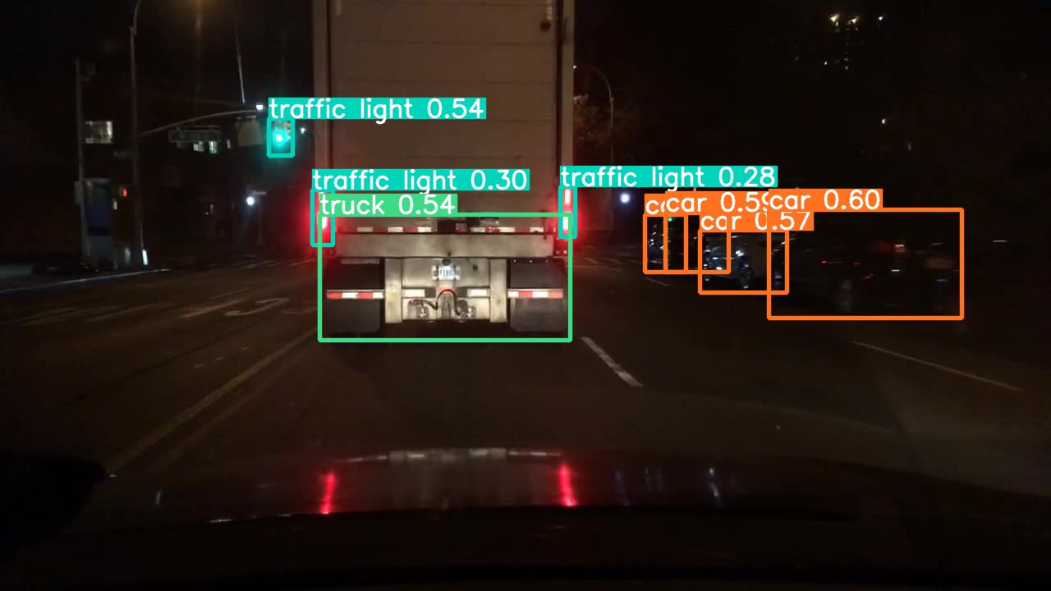
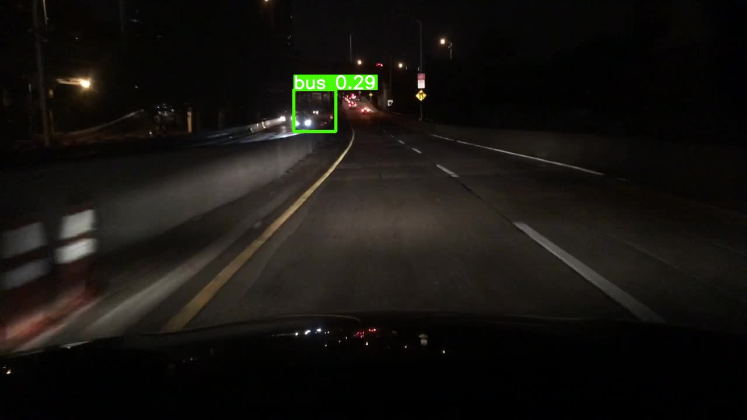

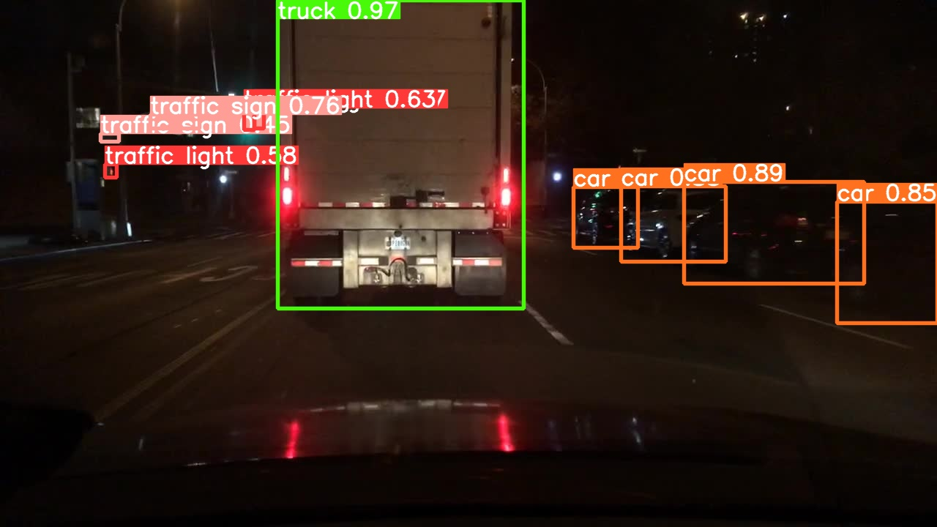
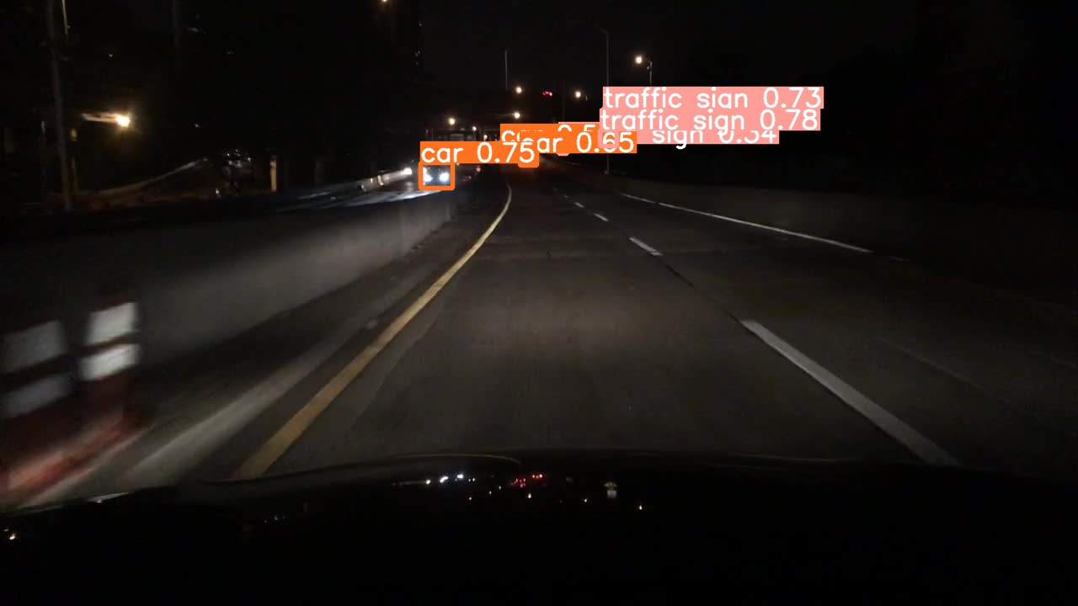
Actual Outcomes
YOLOv5 Object Detection
Pre-trained COCO dataset
After BDD100K dataset training
Notes:
1st column:
Lot of glowing boards of all kinds but both v5 and v7 are doing pretty good job in not misclassifying them as traffic sign boards.
Some pedestrians are being picked up by v7 but missed with v5.
2nd column:
There is a traffic sign mis-classified in v5 at the left.
There is one traffic sign detected in v7. not sure if its right. When zoomed in doesn’t look right.

Slide 15
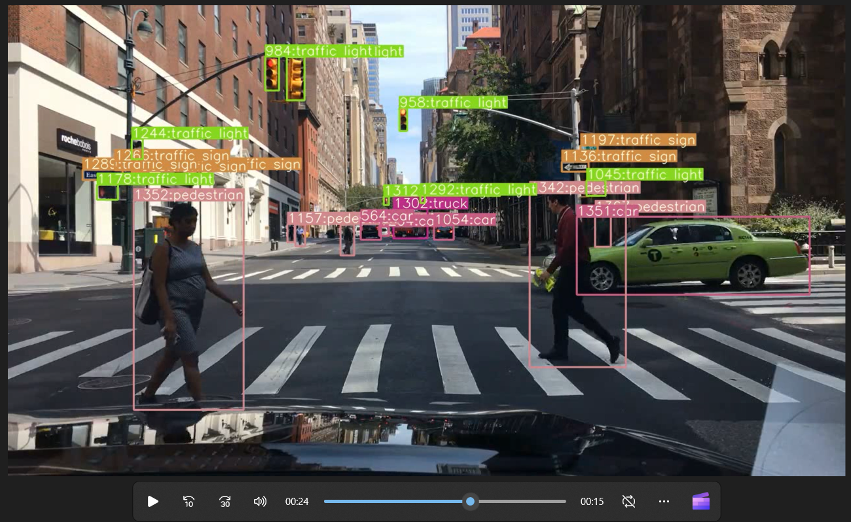
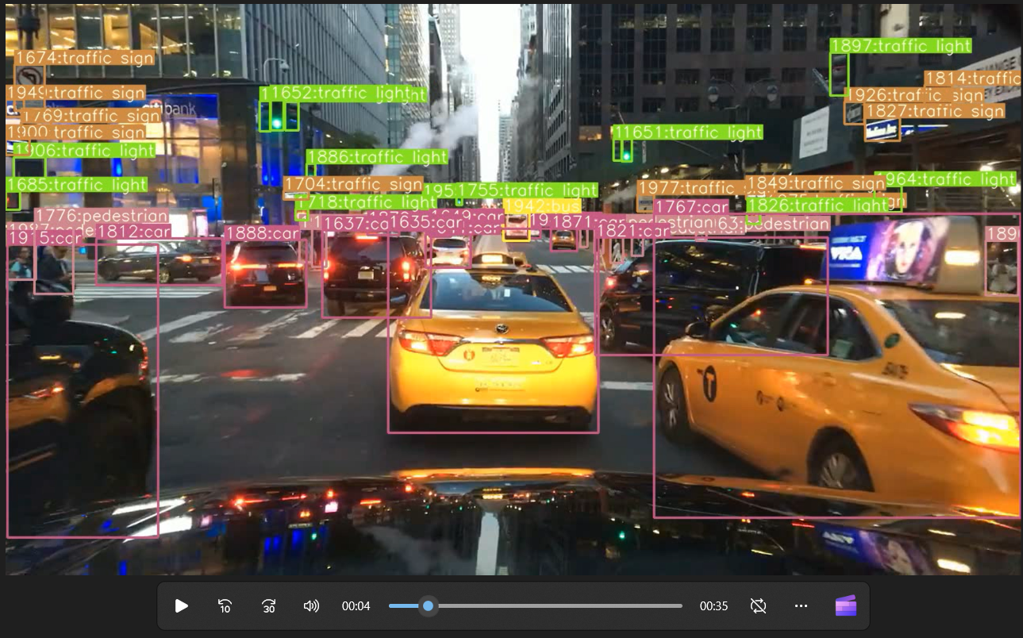
Outcome in stages
Stage 5 – Process videos for object tracking
Notes:
Completely blurred image.
Lot of lights must be cars missed in both.

Slide 16
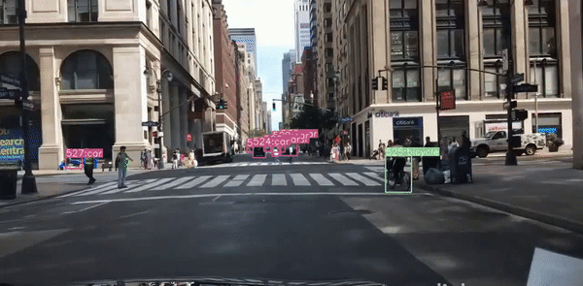
Actual Outcomes
YOLOv5 + Deep SORT tracker output
Tracked GIF via YOLOv5 + DeepSORT

Slide 17
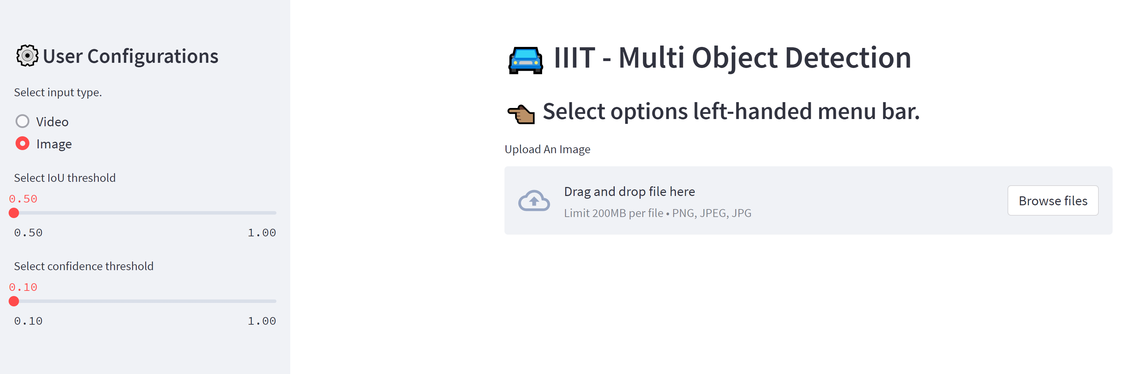
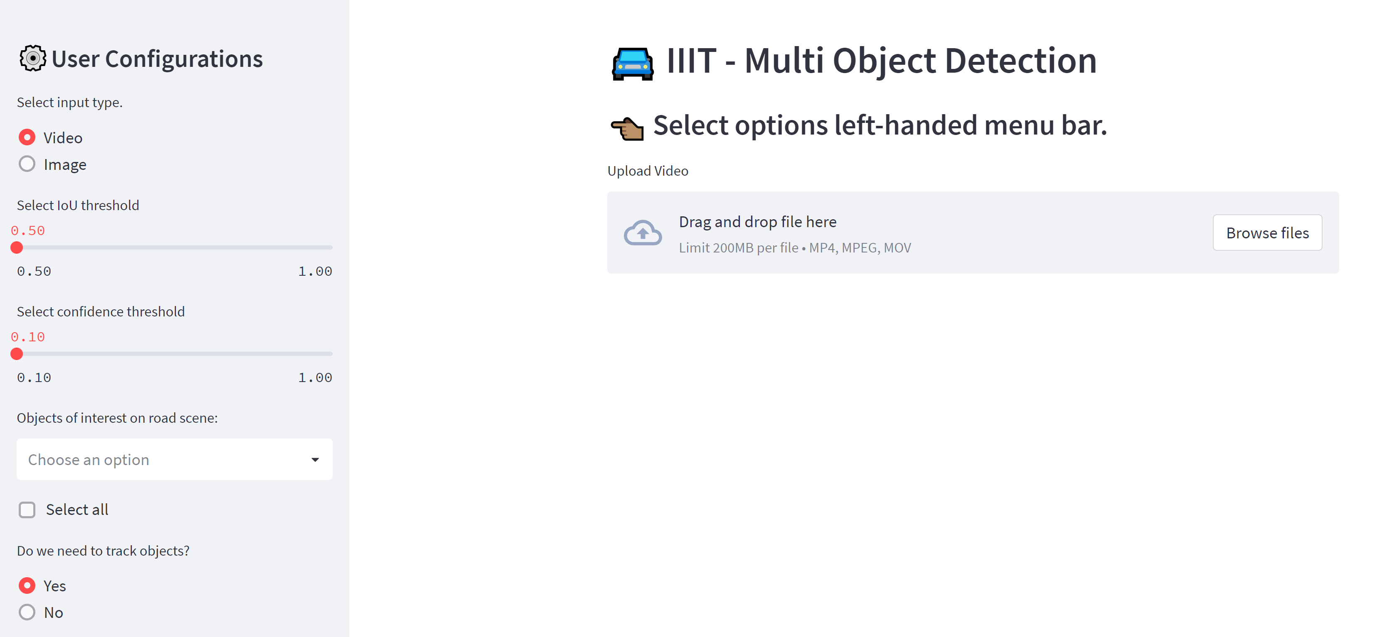
Outcome in stages
Stage 6 – Develop streamlit application and deploy onto Streamlit Cloud
Application for Image detection
Application for Video detection and tracking

Slide 18
Challenges
Missing labels for some of the images of BDD100k data.
Downloading of BDD100k videos were time consuming.
Resource constraint – GPU causing disconnection of runtime in colab.
Sharing GIT Code repositories
Understanding cloud constraints
Understanding installation of packages in streamlit cloud.
How to store the models so as to be loaded in the cloud environment.
Understanding Codec formats compatible with browsers.
Resource constraints while testing the web-UI locally.

Slide 19
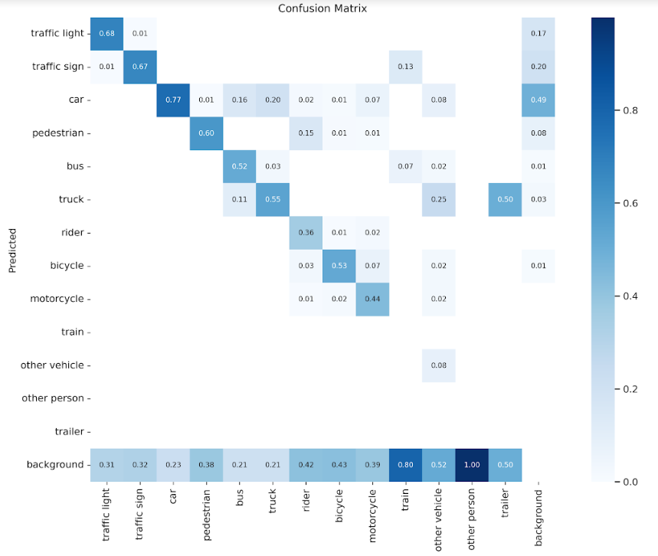
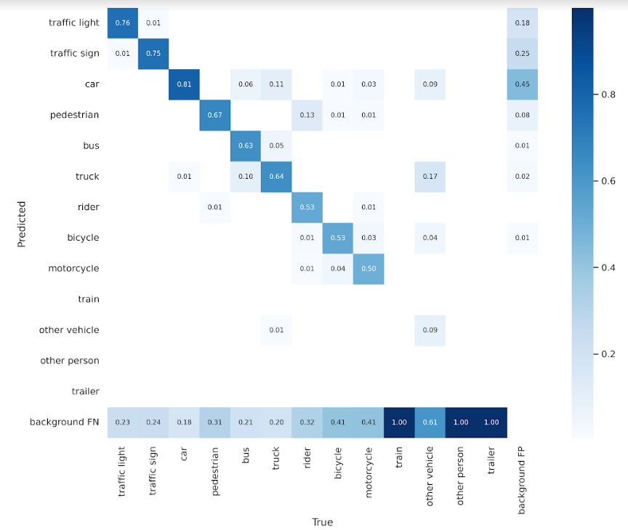
Stretch Goals
YOLOv5 vs YOLOv7
V5
V7

Slide 20
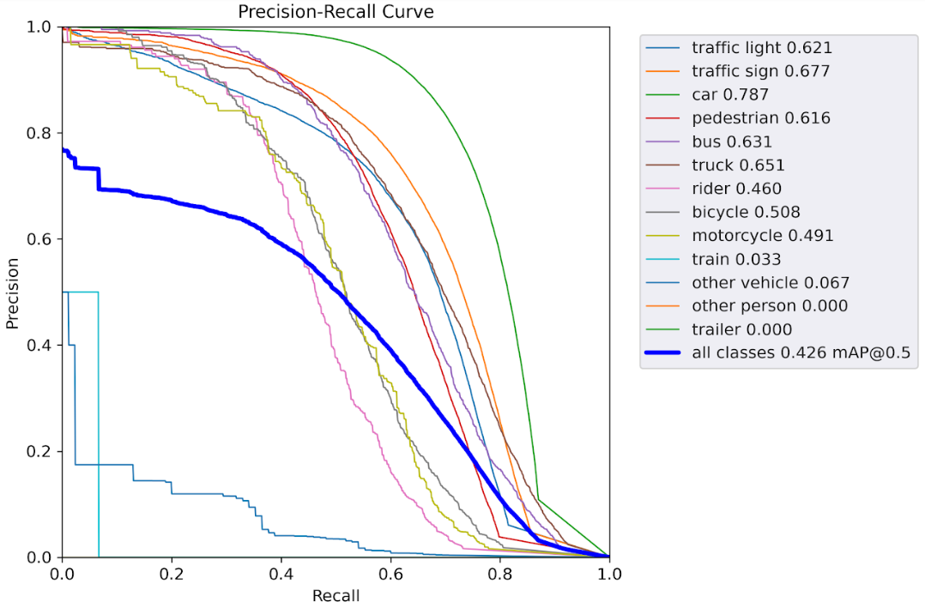
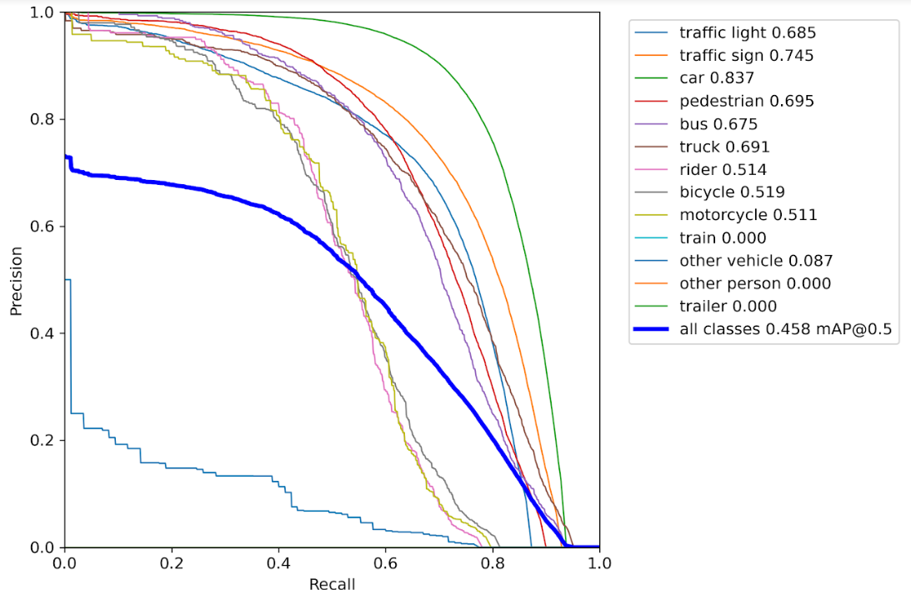
Stretch Goals
YOLOv5 vs YOLOv7
V5
V7

Slide 21
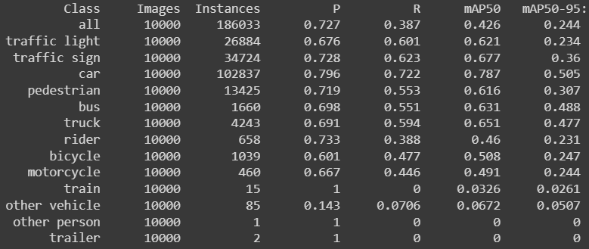
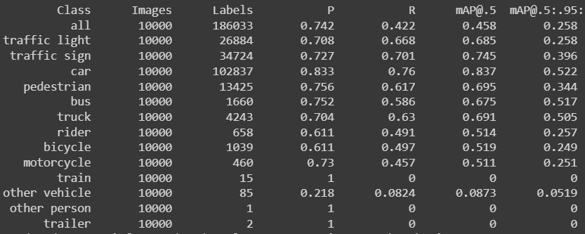
Stretch Goals
YOLOv5 vs YOLOv7
V5
V7

Slide 22
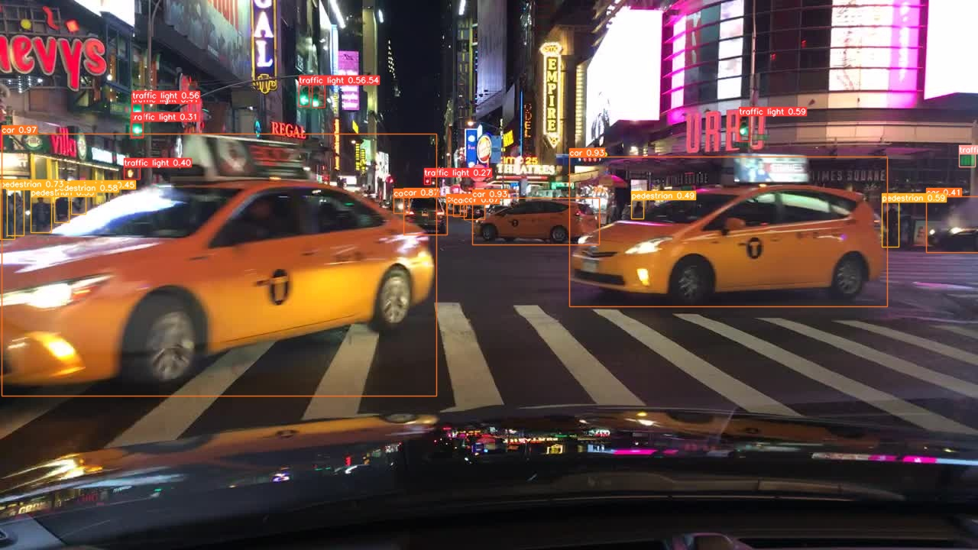
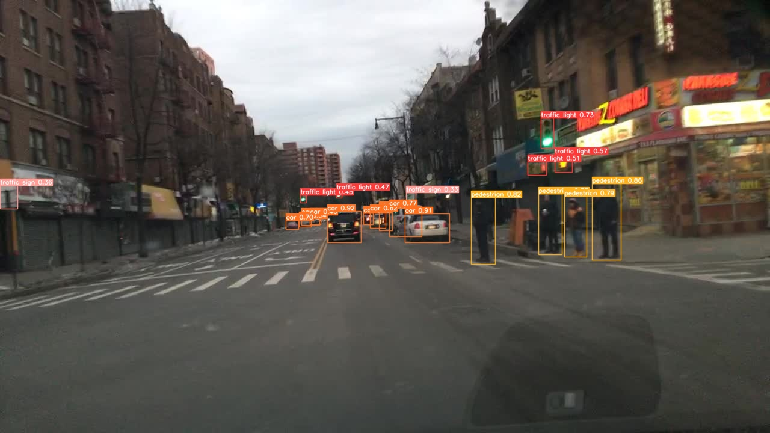
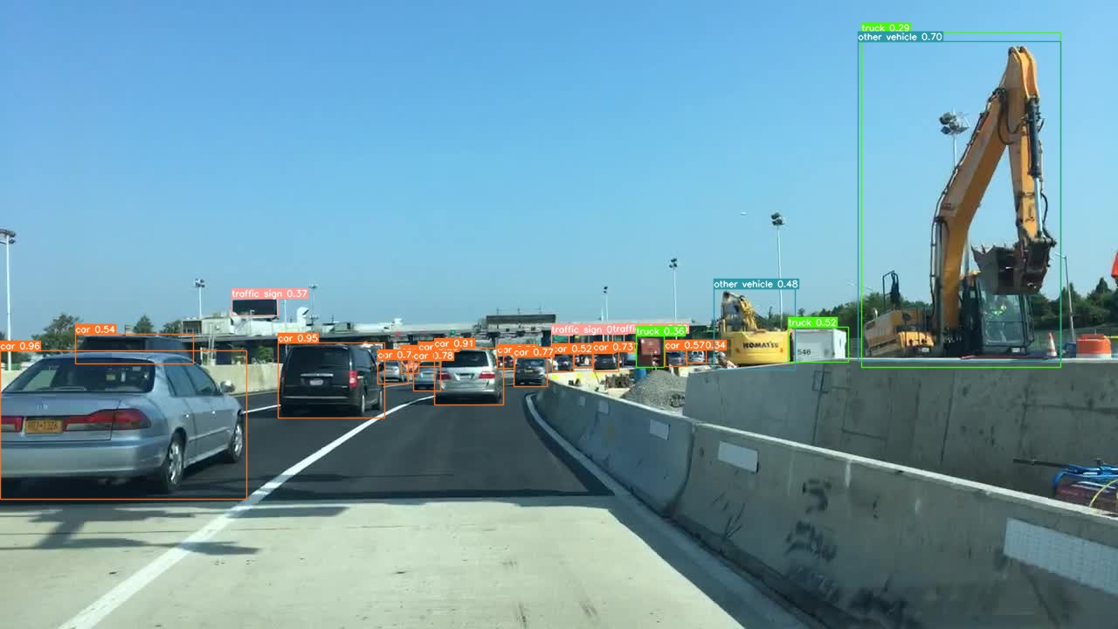
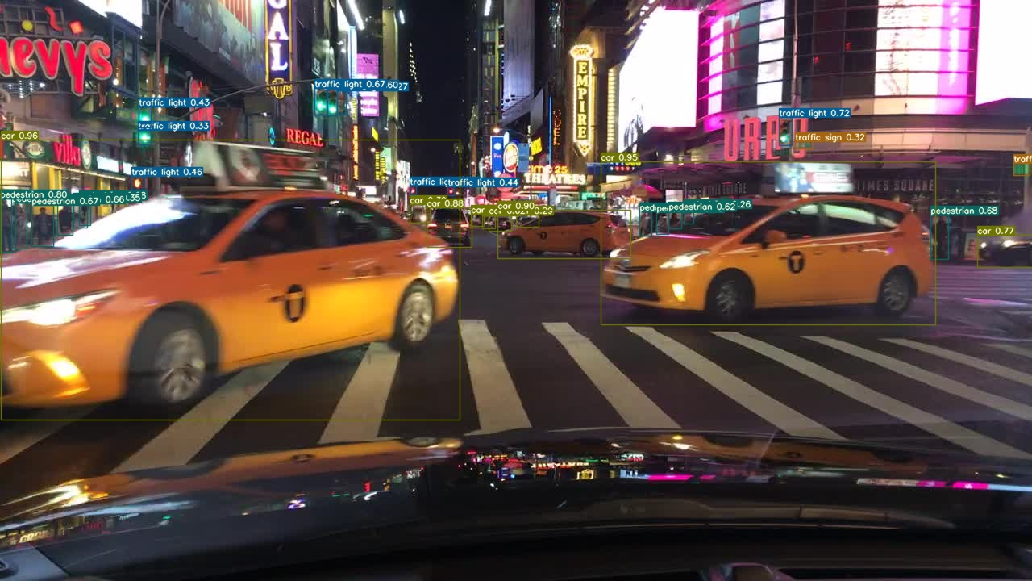
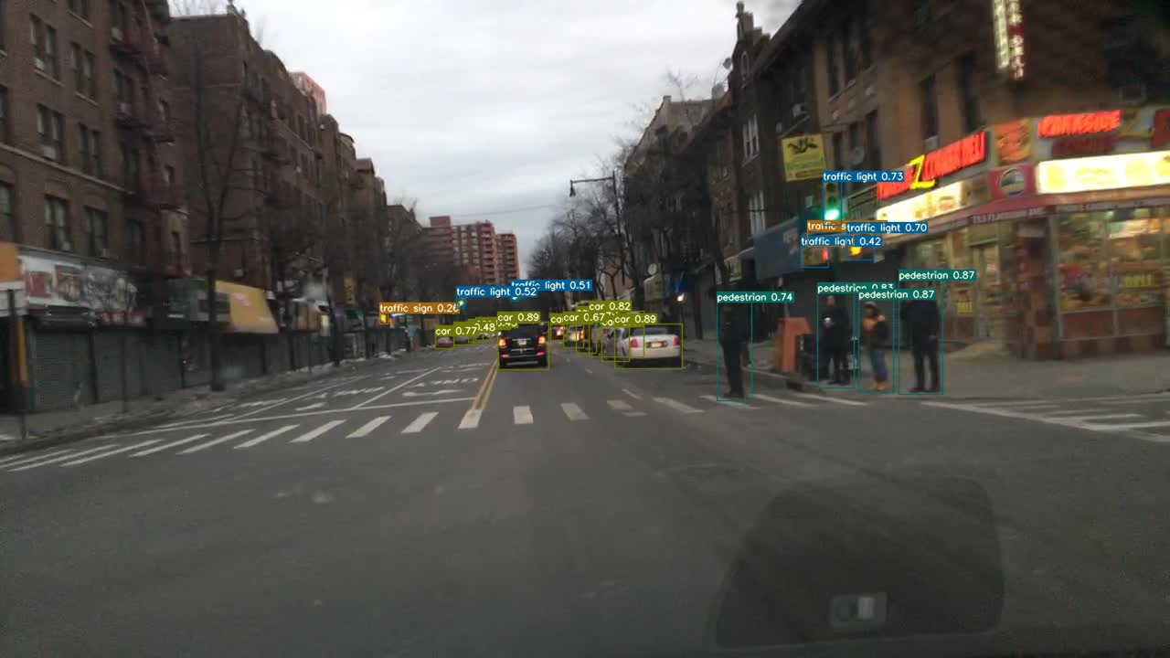
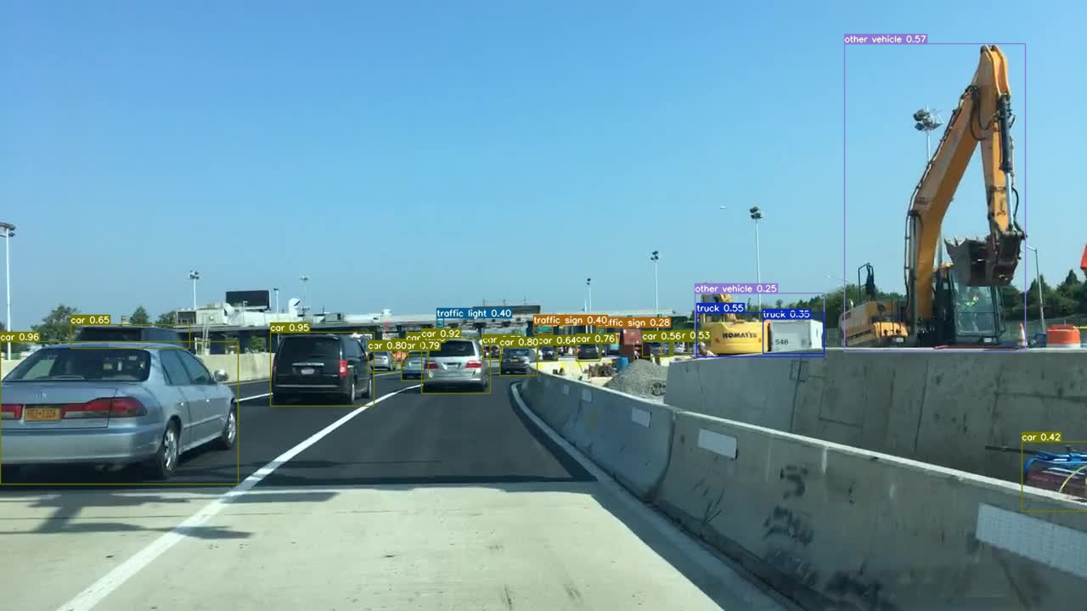
Stretch Goals
YOLOv5 vs YOLOv7
V5
V7

Slide 23
Application Demo

Slide 24
Thank
You

